Slide 1
Semblance
Social without the Media

Slide 2

Mission Statement
Semblance is a website focused on local community-building through facilitating authentic real life interactions.

Slide 3
How it Works: User Input
Choose three archetypes that they identify as
Choose three archetypes that they are looking for
Drag and drop a Google map cursor to a location
Proximity slider (5 miles, 10 miles, etc.)
Gender* radio buttons
Press Submit Button

Slide 4
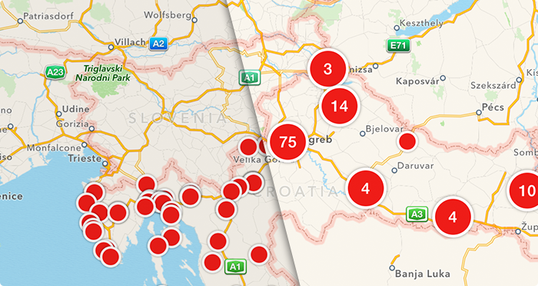
How it Works: App Output
App Output:
top 7 users results + loading more results
A marker clustered total number of results on Google Maps
Chat feature*

Slide 5
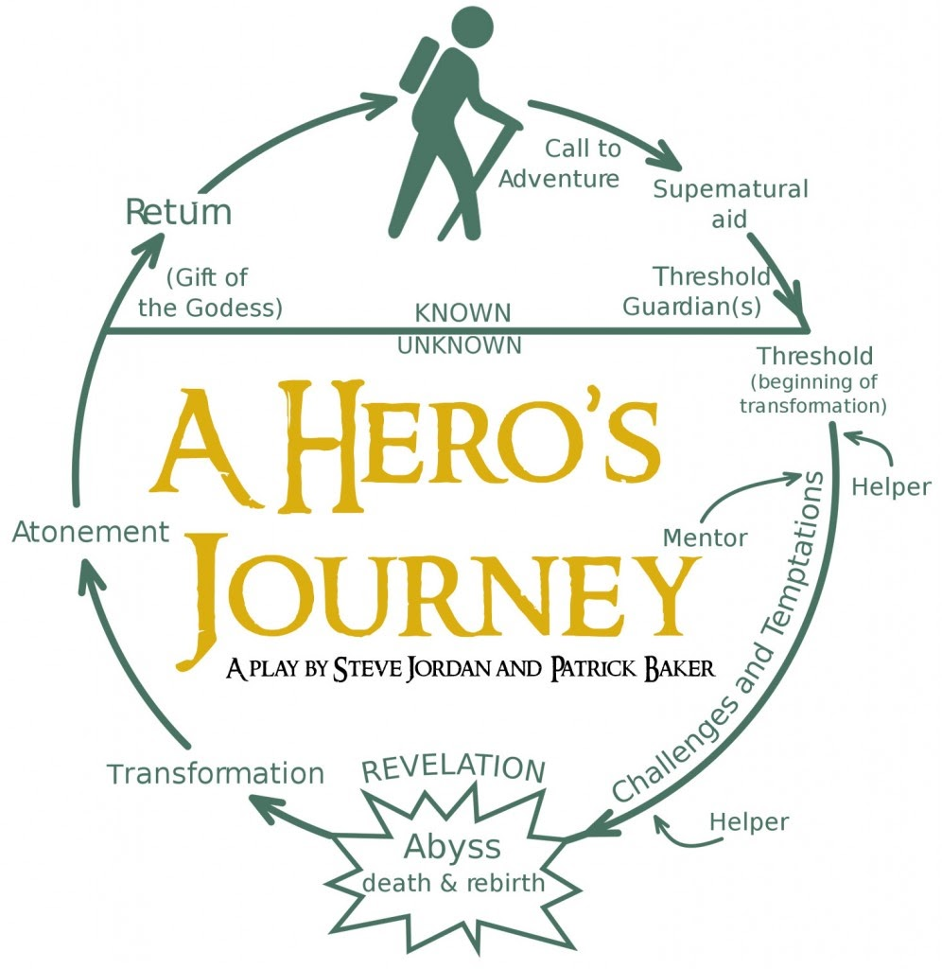
Why Archetypes?
Everyone has a personal narrative often in the shape of the “Hero’s Journey”
Archetypes are reflective of one’s broad emotional state
Cultural neutrality and story-telling roots

Slide 6

Archetype Examples
The Champion
The Leader
The Steward
The Dreamer
The Creator
The Explorer
The Comic
And several more…

Slide 7
Archetype Demo
Hovering
Hovering the archetype shows the archetype’s description
Clicking
Clicking on the Archetype inputs the archetypes into the identity and looking lists in a predictable manner
Delete
Clicking on the delete button deletes the archetype

Slide 8
Proximity and Gender Settings Demo
Drag and drop Google Map cursor
Proximity slider
Gender radio buttons
Gender is meant to be a paid service in the future because the main goal of this application is to meet people locally rather than be specialized for dating.

Slide 9
Results and Chat Demo (pending)
Pressing the submit button causes results to appear
Chatting is somewhat functional

Slide 10
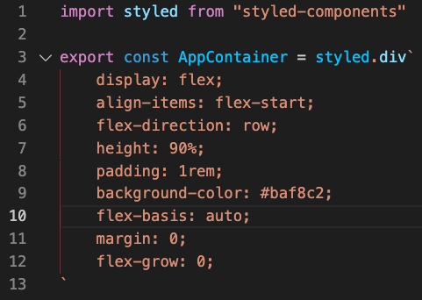
CSS handled by Styled Components
Example of styled components

Slide 11
State Management on the Frontend
How actions change state on the frontend

Slide 12
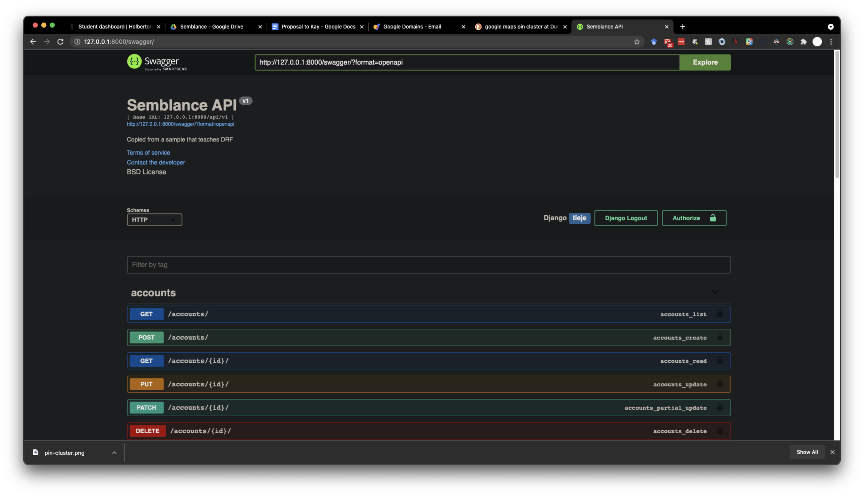
Django REST APIs
How REST APIs look on the backend
Use Swagger to show all URLs

Slide 13
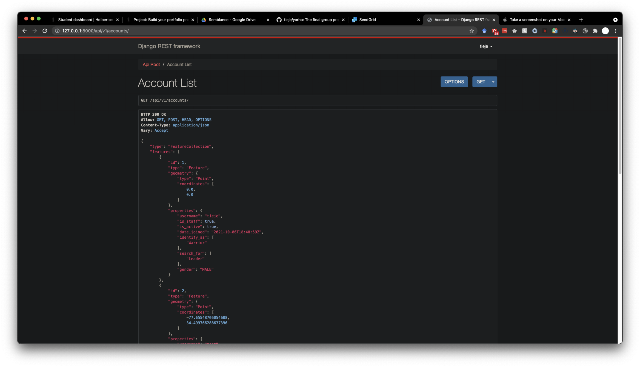

Slide 14
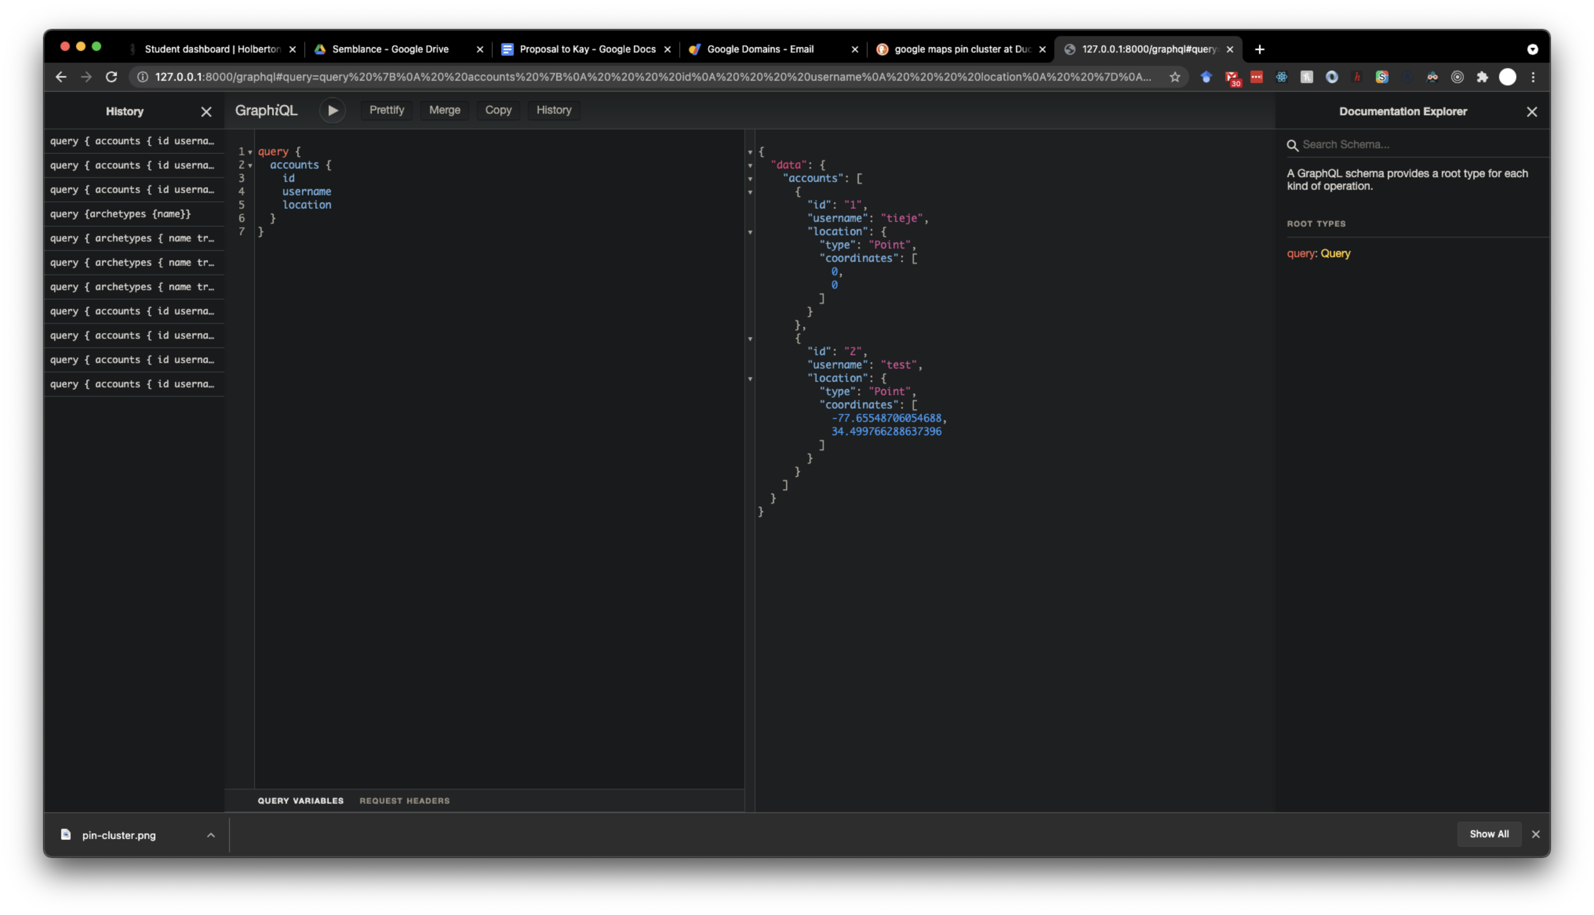
Django + GraphQL = Graphene
How the REST API paradigm is laid to rest with a singular GraphQL endpoint

Slide 15
Docker Usage and PostgreSQL database
Docker is used for containerization
Allows easy PostgreSQL database setup
Docker-compose command used for either development or production

Slide 16
Gunicorn and Nginx
Gunicorn WSGI for the pythonic backend
Nginx web server for the frontend

